Slide 1
AI Empowers Pre-, Intra-, and Post-Consultation Healthcare
Xiangya Hospital Central South University
Prof. Weihong Huang
the 125th IETF Conference,
Shenzhen, China
March 2026

Slide 2
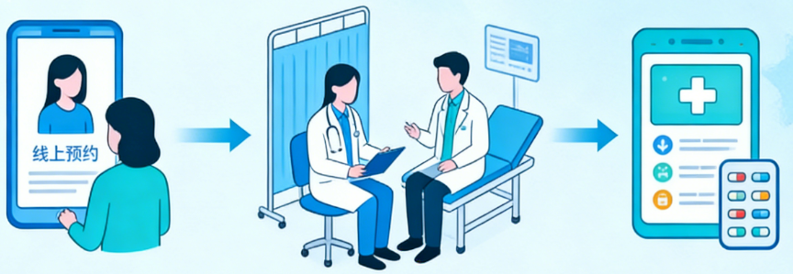
AI Empowers Healthcare: Typical Scenarios and New Network Challenges(1/2)
Typical Application Scenarios of AI + Healthcare
Pre-consultation
Intra-consultation
Post-consultation
Intelligent triage and pre-examination
Core diagnosis and treatment assistance
Whole-life health management
Scenario
AI agents analyze patient symptoms via multimodal interaction, accurately recommend departments, and generate pre-triage reports
Characteristics
High concurrency, high real-time requirements
Case
Life-saving emergency / Pre-diagnosis
Scenario
Imaging analysis, AI-assisted reading
Clinical decision support
Medical record generation
Characteristics
High bandwidth (image transmission), low latency (real-time interaction), extremely high data privacy
Case
Precision control (during diagnosis/surgery)
Scenario
Dynamic management of personal health records; Personalized rehabilitation planning; Remote home monitoring
New drug development; Joint research on difficult cases; Assistance in writing medical papersCharacteristics
Long connections, massive IoT device access
Cross-institutional data collaboration; Elastic computing scheduling
Case
Research (post-diagnosis)
Notes:
结论：传统的“流感知网络”已无法适应AI医疗智能体动态、意图驱动且安全敏感的业务特征。
痛点一：业务的“弹性突发” vs 网络的“静态配置”
挑战：医疗AI训练通常在夜间突发（潮汐效应），推理在白天高峰。传统网络难以秒级弹性调整带宽和算力路径。
Agent价值：预测性资源调度。智能体预判流量洪峰，主动向网络协商临时切片，用完即释。
🔴 痛点二：基础设施的“受限” vs 算力的“无限需求”
挑战：医院机房空间小、电力紧张，无法承载大规模训练；上云则面临网络不稳定风险。
Agent价值：动态云边协同。智能体根据实时网络状态，动态拆分任务：轻量推理在边缘（医院），重训在云端，自动选择最优路径。
🔴 痛点三：数据的“主权隔离” vs 科研的“跨域共享”
挑战：医疗数据严禁出域，但科研需要跨院协作。传统防火墙/ACL策略僵化，开通专线周期长（数周）。
Agent价值：基于意图的零信任安全。智能体携带安全意图（如 {模式：联邦学习，范围：仅梯度参数}），网络自动构建临时、逻辑隔离的安全隧道，任务结束自动销毁。
呼吁：IETF需推动网络架构向“智能体策略感知网络 (Agent Policy-Aware Network)”演进，实现业务意图与网络资源的自动闭环协同。

Slide 3
AI Empowers Healthcare: Typical Scenarios and New Network Challenges(2/2)
Internet challenges
Pain Point 1
Pain Point 2
Pain Point 3
"Elastic Bursts" of Business
"Limited" Infrastructure
"Sovereign Isolation" of Data
vs
vs
vs
"Static Configuration" of Networks
"Unlimited" Compute Demand
"Cross-Domain Sharing" for Research
AI Agents advantages
Advantage 1
Advantage 2
Advantage 3
Agents forecast traffic peaks
negotiate temporary slices, maximizing resource utilization.
Proactively negotiate temporary slices with the network and release them when they are used up
ynamic Cloud-Edge Collaboration
Agents split tasks based on real-time network conditions
light inference at the edge
heavy training in the cloud
auto-select optimal paths
Intent-Based Zero-Trust Security
Agents carry security intents (e.g Federated Learning), and the network automatically constructs temporary, logically isolated secure tunnels
Automatically destroyed after completion

Slide 4



Home Emergency Rescue and Zero-intervention Guarantee for the "Golden Time"
Intelligent health monitoring devices worn by elderly people living alone detect sudden falls and abnormal vital signs through multimodal sensors (accelerometers, vision, heart rate monitors)
Traditional Process：
Device alarm → Cloud notifies family/community → Manual dial of 120 → Ambulance dispatch → On-site first aid → Data transmission to hospital (often with delays or disconnections)
AI Agent-driven Process:
The home health AI agent judges the crisis level in an instant and triggers the "Emergency Rescue Mode" automatically
Without manual confirmation, it directly calls the emergency center AI agent, and collaborates with the network to establish an exclusive, ultra-low latency, high-security transmission tunnel, which continuously pushes real-time HD video and vital sign data streams to the emergency department of the nearest hospital and the on-board terminal of the ambulance
Service Agent
Network Equipment
Emergency Data Stream
Network Equipment
Dynamic Slicing
Seamless Handover
Intent: {Emergency, Low-Latency, High-Sec}
Network Equipment
Network Equipment
In this scenario, the AI agent is not only an alarm sender, but also a network scheduler and policy expresser
Proactive Intent Expression
The AI agent clearly declares policy intents to the network: {Service Type: Emergency Video Stream} + {Performance Requirements: Latency < 20ms, Zero Packet Loss} + {Security Level: Highest Privacy Protection} + {Constraints: Prioritize Occupancy of Any Available Slicing}
Dynamic Resource Locking
When the public network is congested (e.g., morning and evening rush hours), the AI agent forcibly seizes network resources through interaction with the network to ensure non-freezing of emergency data transmission.
End-to-End Collaborative Decision-Making
When the elderly is carried into the ambulance and the network environment switches from Wi-Fi to 5G/6G, the AI agent negotiates with the network agent to achieve "lossless handover", ensuring the images seen by doctors are uninterrupted and clear to support remote first aid guidance.

Slide 5
Cross-regional Medical Consortium Construction and Privacy Computing Collaboration
Multiple top-tier hospitals (in different provinces/trust domains) intend to jointly train an AI diagnostic model for rare difficult and complicated diseases
Pain Point:
Medical data (medical records, imaging) is strictly prohibited from being transmitted across domains (Data Sovereignty)
hospital networks are isolated from each other
the traditional dedicated line opening cycle is long (weeks) and cannot dynamically adapt to the sudden bandwidth demand of training tasks
AI Agent-driven Process:
Research collaboration AI agents of each hospital initiate joint training requests
AI agents automatically exchange identity credentials and trust domain attributes, and the network automatically builds a temporary, logically isolated ultra-high-security virtual private network
Data never leaves the hospital, only encrypted gradient parameters or feature values are exchanged, and network policies are automatically destroyed after the task ends
Industry Cloud
Hospital Campus A
Hospital Campus B
Network Equipment
Network Equipment
Dynamic Trust Domain Matching
Quantum-Safe Encryption
Federated-Learning-Only
Security Authentication
Hospital Campus C
Network Equipment
Network Equipment
Hospital Campus D
Dynamic Zero-Trust Security Adaptation
Based on the identity of collaborators,the AI agent automatically applies to the network for matching security policies. The network distributes security policies automatically without manual configuration of firewall whitelists
Tidal Resource Scheduling
AI training is usually conducted at night. The AI agent predicts traffic peaks and sends the intent {Resource Reservation: 22:00-06:00, Bandwidth: 100Gbps} to the network. The network automatically allocates large-bandwidth slicing during off-peak hours and reclaims it in the morning to maximize resource utilization
Automatic Compliance Audit
The AI agent monitors data flow in real time; once unauthorized data is detected attempting to flow out of the trust domain, it immediately instructs the network to block and issue an alarm

Slide 6
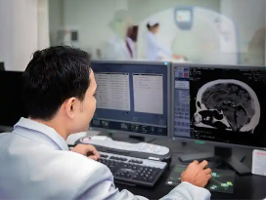
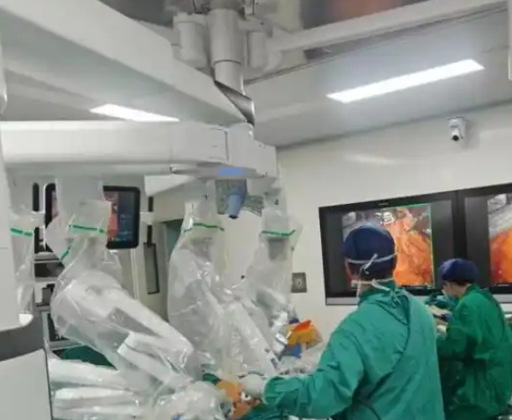
Remote Surgical Robots and Multimodal Haptic Feedback
Experts at top-tier hospitals in Beijing perform high-precision surgeries for patients in border areas by controlling remote surgical robots
Challenge: Surgery requires not only 4K/8K ultra-HD video, but also millisecond-level haptic feedback. Any slight network jitter or latency may cause scalpel deviation and endanger lives
AI Agent-driven Process：
The surgical robot AI agent perceives operation force and network quality in real time
When microsecond-level jitter is detected on the current path, it proactively sends the instruction to the network without waiting for network alarms
The network immediately calculates and switches to a more stable path, with no perception by patients and doctors during the whole process
Network Equipment
path1：Jitter/Congestion
Network Equipment
path2：Millisecond-level Response
Fault Self-Healing
Network Equipment
Network Equipment
Precise Mapping of Business Semantics and Network Characteristics
The AI agent knows that the "tissue cutting" action requires extremely high stability, while the "field of view observation" action can tolerate slightly higher latency. It converts such business semantics into specific network SLA indicators (e.g., Jitter < 1ms, Packet Loss = 0), a level of refinement unattainable by traditional DSCP marking
Predictive Path Optimization
Based on historical data and real-time probes, the AI agent predicts potential congestion on a certain link in the next few seconds and instructs the network to perform pre-handover in advance, achieving true "fault self-healing" rather than "post-fault recovery"
Multi-dimensional SLA Guarantee
Coordinate the priority of video streams (large bandwidth), control signaling (low latency) and haptic data (high reliability) at the same time, ensuring that life-critical control signaling always has the highest priority when bandwidth is limited

Slide 7
Summary: Why AI Agents are Indispensable for These Scenarios
Features | Traditional Network (QoS/SDN) | AI Agent Network | Value in Healthcare Scenarios
Perception Object | Data flow, ports, IP | AI agent intent, business semantics | Understanding "emergency rescue" is more important than "video stream"
Decision Mode | One-way network configuration, static rules | Two-way collaboration, dynamic negotiation | Robots can proactively request "lossless handover"
Security Mechanism | Static ACL | Dynamic zero-trust, based on identity/context | Automatic matching of privacy policies for cross-hospital collaboration
Response Speed | Second to minute level (post-fault) | Millisecond level (prediction and prevention) | Seizing the "golden rescue time"
Resource Efficiency | Exclusive or static allocation, severe waste | Tidal scheduling, on-demand allocation | Automatic bandwidth release for night training

Slide 8
Open for Discussion
Thank You！

